Slide 1
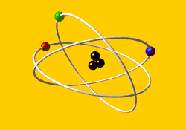
NSDD LBNL Isotopes Project Collaboration Report
Richard B. Firestone
Isotopes Project, Lawrence Berkeley National Laboratory, Berkeley, CA 94720
USNDP

Slide 2
Isotopes Project Group Members
Richard B. Firestone – Group Leader
Coral Baglin – Staff scientist
Shamsu Basunia – Staff scientist
Aaron Hurst – Staff scientist
Edgardo Browne – Emeritus staff scientist
Andrew Rogers – Postdoc

Slide 3
Isotope Project Collaborators
LLNL/LBNL ENDF γ-ray Library – B. Sleaford, N. Summers, J. Escher
LLNL National Ignition Facility – L. Bernstein
UC Berkeley Nuclear Engineering – K. van Bibber, K.-N. Leung
Budapest Reactor – T. Belgya, L. Szentmiklosi
Garching FRM-II Reactor – Zs. Revay, P. Kudejova
Charles University, Prague – M. Krticka, F. Becvar
YD Impact – A. West, J. Kennett, T. Bunch, J. Hagstrum, ……..
Evaluation of Particle/γ-ray Continuum Data – S. Siem, M. Guttormsen, A.-C. Larsen (Oslo Cyclotron)
TransActinide Nuclear Data Evaluation and Measurement (TANDEM) – M. Rossbach, C. Genreith (Jülich Forschungszentrum)

Slide 4
Isotopes Project Activities
Evaluated Gamma-ray Activation File (EGAF)
Neutron capture γ-ray cross sections, σ_{γ}
Thermal neutron cross sections, σ₀
Activation data – P_{γ}, σ_{γ}
Neutron separation energies, S_{n}
RIPL nuclear structure data – Adopted Levels
IAEA/LBNL website - http://www-nds.iaea.org/pgaa/
Mass Chain Evaluation - A=21-30
Cross Section Measurements
Thermal neutron beams – FRM II (Munich), Budapest
UC Berkeley neutron generator facility
LLNL National Ignition Facility (NIF)
MeV Neutron Beams – LBNL cyclotron
Surrogate reactions – STARS/LiBeRACE
Astrophysics, asteroid impact events, climate change
Statistical Model Calculations – DICEBOX (Charles Univ. Prague)

Slide 5
Isotopes Project Data Evaluations
EGAF evaluation – reported later in this meeting
Mass chain evaluation
A=27, Nuclear Data Sheets 112, 1875-1948 (2011)
A=29, Nuclear Data Sheets 113, 909-972 (2012)
A=92, Nuclear Data Sheets 113, 2187-2389 (2012)
A=93, Nuclear Data Sheets 112, 1163-1389 (2011)
A=99, Nuclear Data Sheets 112, 275-446 (2011)*
A=143, Nuclear Data Sheets 113, 715-908 (2012)*
A=192, Nuclear Data Sheets 113, 1871-2111 (2012)
A=220, Nuclear Data Sheets 112, 1115-1161 (2011)*
A=230, Nuclear Data Sheets 113, 2113-2185 (2012)*
A=245, Nuclear Data Sheets 112, 447-494 (2011)*
A=246, Nuclear Data Sheets 112, 1833-1873 (2011)*
*Evaluation supported by the NNDC

Slide 6
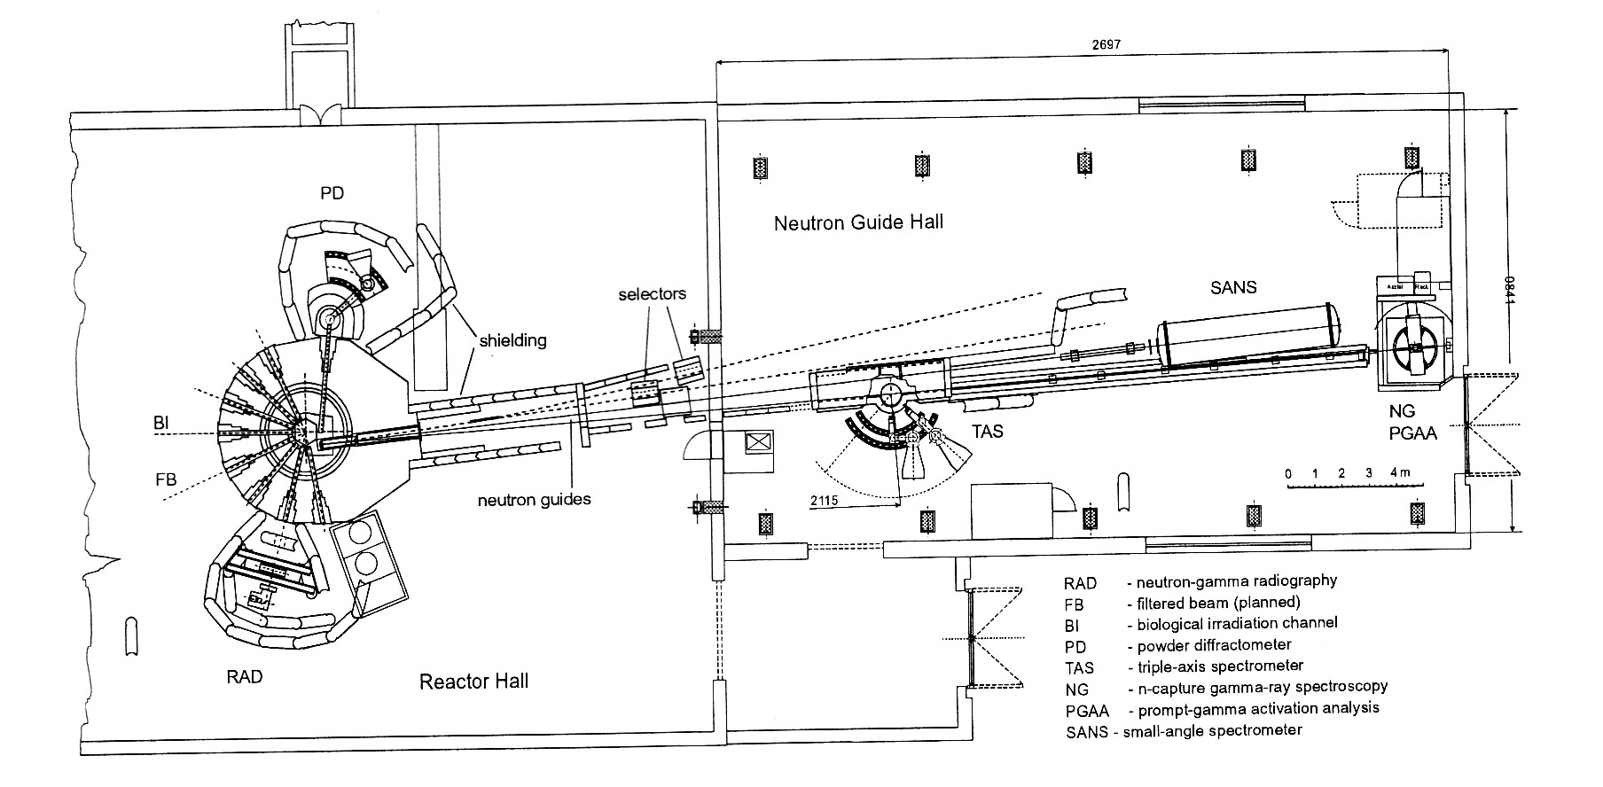
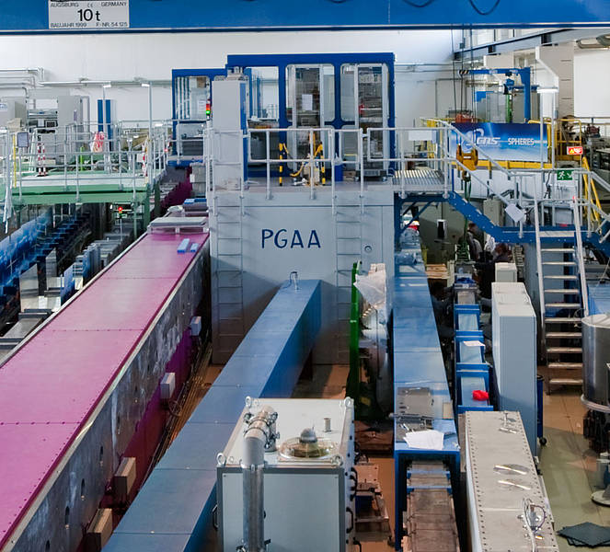
Thermal Neutron Measurements
Budapest Reactor and neutron guide hall. The PGAA (capture gamma) station is located ≈30 m from the reactor wall.
5×10⁷ n/cm²s
Compton suppressed HPGe detector. Resolution: <1% for E=0.5-6 MeV, <3% 0.05-0.5 MeV and >6 MeV.
FRM II (Garching) - 6×10¹⁰ n/cm²s

Slide 7
Thermal Neutron Measurements
Internal calibration of γ-ray cross sections (σ_{γ}) using stoichiometric compounds or mixtures containing standards, e.g. H, N, Cl, S, Na, Ti, Au.
Budapest measurement - enriched isotopes ^{151,153}Eu, ^{155,157}Gd, ^{182,183,184,185}W
FRM II (Garching) measurements – YD Impact samples
Approved measurements FY2013 – ^{70,72,73,74,76}Ge, ^{90,91,92,94,96}Zr, ²³⁸U
Younger Dryas Impact samples (geology)

Slide 8
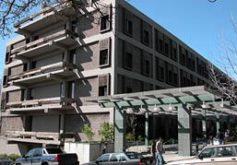
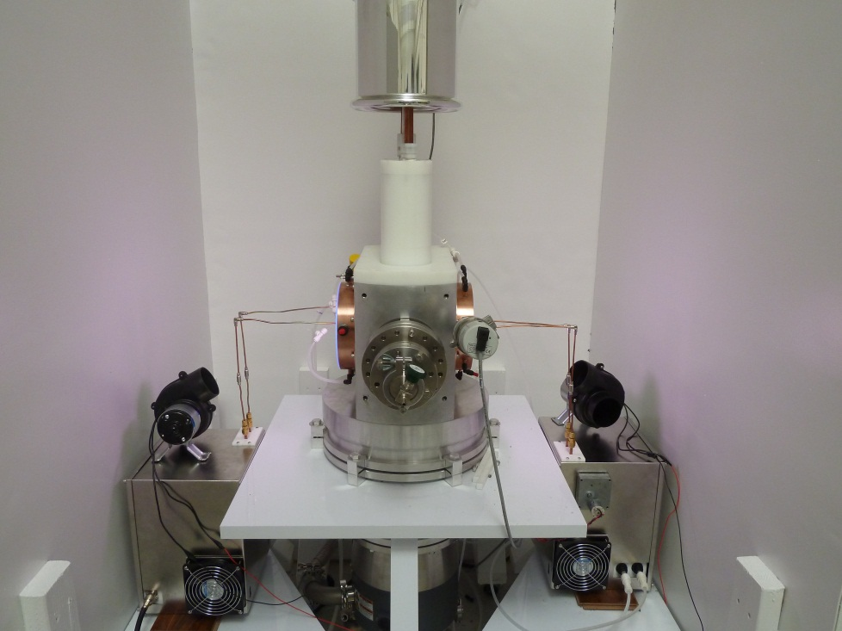
UC Berkeley Neutron Generator Laboratory
5×10¹¹ n/s D+D neutron generator is being installed at Etcheverry Hall on the UC Berkeley campus.
On-line summer 2013
10¹⁰ n/cm²s at the target area
Built by NSF for Ar-Ar dating
Available for ≤2.5 MeV cross section measurement

Slide 9
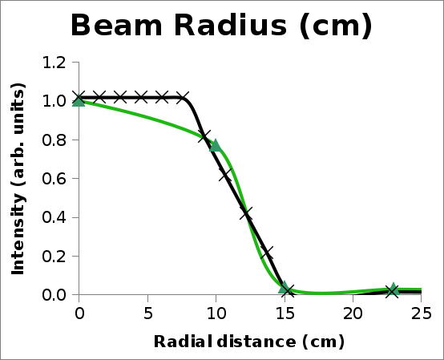
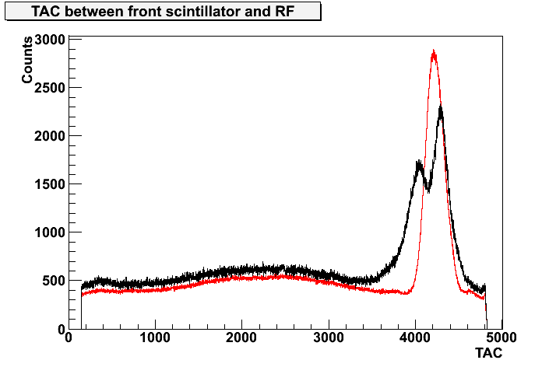
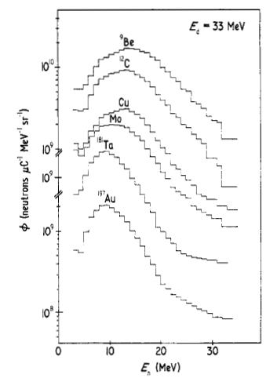
Neutron Beams at the 88” Cyclotron
The facility can supply a tunable, monoenergetic neutron beams in the range of 8-33 MeV, up to >10⁸ n/cm²s, by deuteron break up. 5-10 m flight path. Flux is 100× WNR 60R flux at these energies.
First experiment 10/7/2012 (LLNL/LBNL)
X(d,n)
Beam profile from different scintillator positions. R=12 cm for 7 m flight path.
Retuning cyclotron eliminated double peak giving 1 ns fwhm timing.
6×10⁸ n/s·cm², Be target,, 10 μA.
Activation
measurements

Slide 10
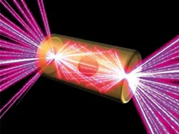
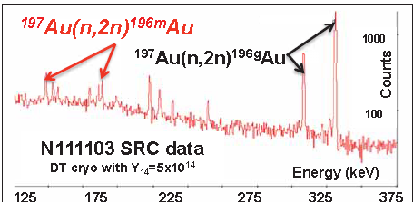
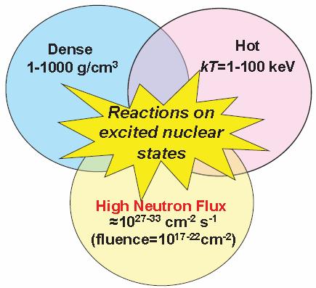
National Ignition Facility (NIF)
192 beams of lazer light converge to deliver 500 terawatts of peak power and 1.85 megajoules of ultraviolet laser light within a few picoseconds.
Debris collected for decay measurements
Nuclear physics in the plasma – experiments under nucleosynthesis conditions.
Measurement of ¹⁹⁷Au(n,2n)¹⁹⁶Au^{g+m} ratio
Ratio varies with photon flux - First observation of photonuclear reactions on excited state

Slide 11
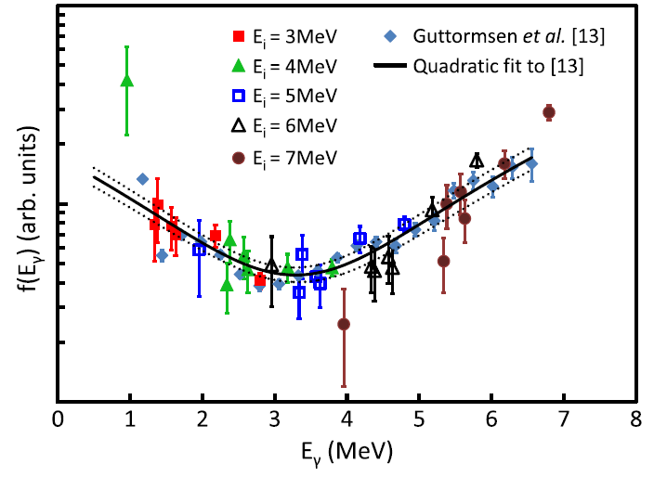
Statistical Photon Strengths
Mysterious upbend in the ⁹⁵Mo(d,p)⁹⁶Mo photon strength measured at STARS/LiBeRACE.
Phys. Rev. Lett. 108, 162503 (2012)
Determination of primary γ-ray E1 photon strength from EGAF primary γ-ray data
$$f_{γ}=\frac{σ_{γ}Γ_{γ}}{σ_{0}d_{0}E^{2l+1}}$$

Slide 12
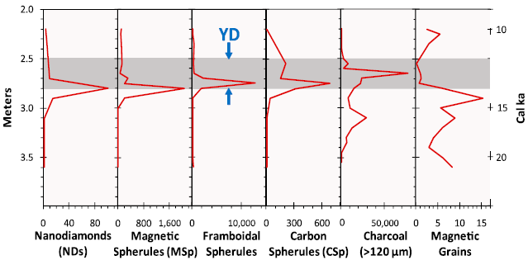
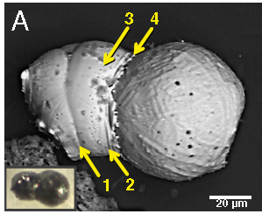
Younger Dryas Impact
Three PNAS Papers in 2012
Evidence from central Mexico supporting the Younger Dryas extraterrestrial impact hypothesis, Proc. Nat. Acad. Sci. 109, E738–E747 (2012).
Very high-temperature impact melt products as evidence for cosmic airbursts and impacts 12,900 years ago, Proc. Nat. Acad. Sci. 109, 11066–11067 (2012).
Independent evaluation of conflicting microspherule results from different investigations of the Younger Dryas impact hypothesis, Proc. Nat. Acad. Sci. 109, E2960–E2969 (2012).
Collision of two molten spherules forming compression rings (1,2), line of gas vesicles (3), and a splash apron (4)
Confirmation – refutation of conflicting results
We found abundant YDB microspherules at all three widely separated sites consistent with the results of Firestone et al. and conclude that the analytical protocol employed by Surovell et al. deviated significantly from that of Firestone et al.

Slide 13
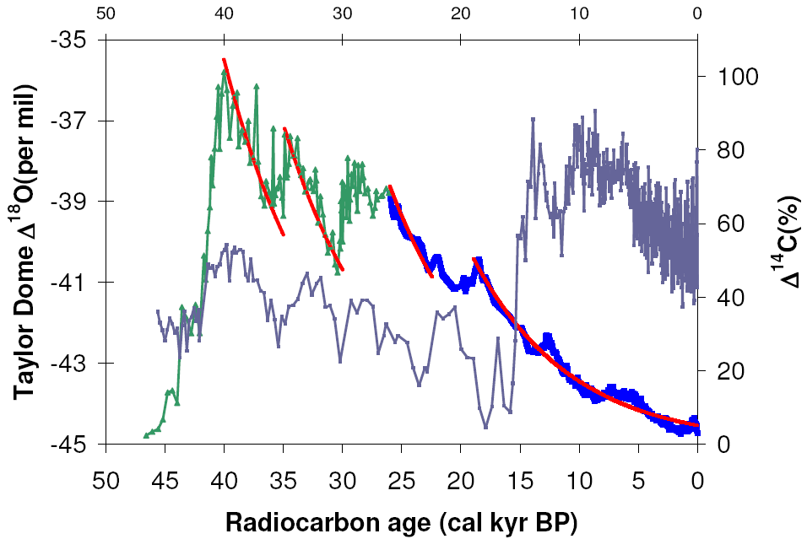
Near-Earth Supernova Discoveries
44 ka
Variation in Δ¹⁸O (temperature)
37 ka
Vela SN
32 ka
22 ka
Four prehistoric supernovae <300 pc from Earth discovered in the radiocarbon record coincide with increases in global temperature (submitted to PNAS).

Slide 14
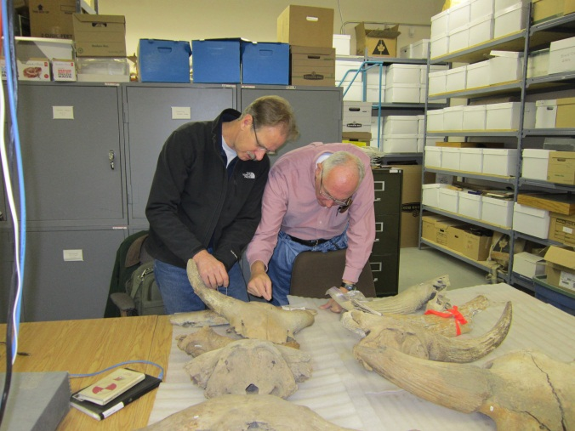
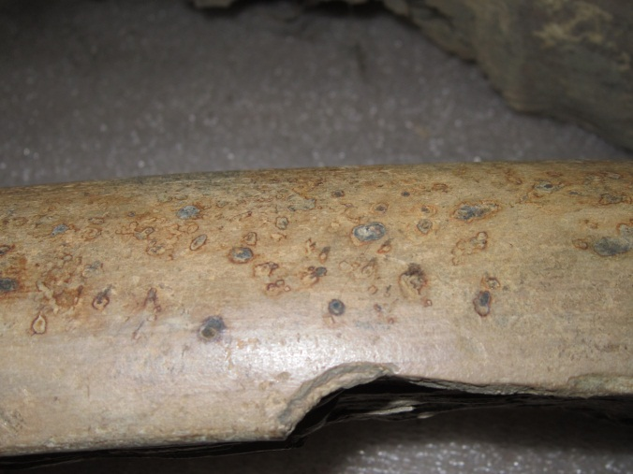
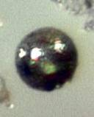
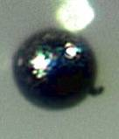
Beringian Impact
Expedition to Whitehorse, Yukon to search for fossils impacted by meteoritic particles.
Meteorites embedded in a Klondike mammoth tusk
Abundant magnetic and glass spherules and magnetic grains were found in sediment concreted to fossils containing impact evidence.

Slide 15
Isotope Project Future Plans
Mass chain evaluation
Evaluation of A=21-30
EGAF Capture γ-ray evaluation - publication in Nuclear Data Sheets?
(n,γ) Adopted Levels, Gamma → EGAF, RIPL,(ENSDF)
Ε_{γ}, σ_{γ}, σ₀ → EGAF, ENDF
Activation data → EGAF, DDEP,(ENSDF)
S_{n} → EGAF, Atomic mass evaluation
Capture γ-ray cross section measurements
Thermal: All isotopes Z=1-60, 62-83, selected actinides
2.5-33 MeV: Prompt, delayed cross sections, all elements
Statistical model studies
DICEBOX calculations
Primary γ-ray photon strength functions
Surrogate reaction measurements
Impact studies – broken fossils and treed jumbled in Alaskan muck

Slide 16
Thank you for your attention

